Slide 1
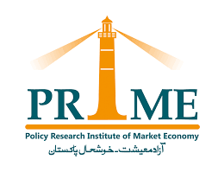
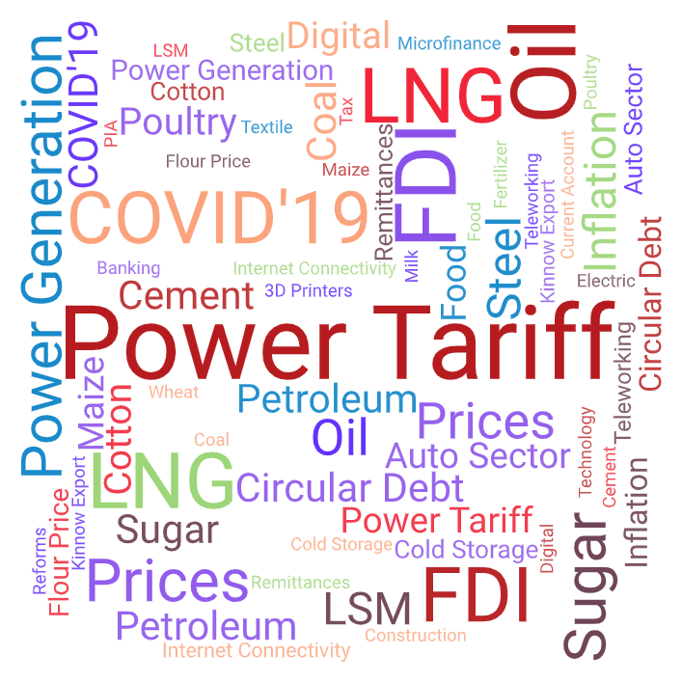
Pakistan prosperity index
February 2021

Slide 2
Policy Research Institute of Market Economy (PRIME) is a public policy think tank striving for an open, free and prosperous Pakistan by creating and expanding a constituency for protective function of the state and freedom of the market.
Pakistan Prosperity Index (PPI) is a monthly review of Pakistan's macro-economy based on the analysis of four periodic data sets- industrial production, trade volume, price levels, and private sector lending. On a 12-month rolling basis, this issue of the report covers the period January 2020 to December 2020, with June 2019 as the base period.
Credits
The idea of PPR was developed by Ali Salman. Special thanks to Ali Kemal for technical support in developing the indices and Sohaib Jamali for his valuable feedback. The title page is based on a word cloud generated from the Business Recorder for December 2020.
Author
Beenish Javed
Email: research@primeinstitute.org
Published by: Policy Research Institute of Market Economy (PRIME)
February 2021
© PRIME Institute
All publications by PRIME can be viewed online at primeinstitute.org

Slide 3
Variables & Data Source
Variable | Source | Time period covered
1. Consumer Price Index (CPI) | State Bank of Pakistan | January 2020 – December 2020 Base month: June 2019
2. Long-term Financing Facility (LTFF)
3. Quantum Index of Large-scale Manufacturing (QIM) | Pakistan Bureau of Statistics
4. Trade Volume
*Refer to end slide for methodology.

Slide 4
Pakistan prosperity index (PPI)
Economy continues to move forward amid Covid-19
Despite the global economic challenges, over a 12-month period Pakistan Prosperity Index faces an upward-sloping trajectory reaching an all-time high of 125.3 in December 2020.
This figure signals economic rebound and improved business confidence.
Source: Author’s calculations based on SBP and PBS datasets.

Slide 5
Purchasing power index (ppi)
Y-o-Y inflation eases in December 2020 hovering at 8%.
Following the first wave of COVID-19, purchasing power witnesses modest increase in 7 months.

Slide 6
Large-scale manufacturing index (LSMI)
Output of large-scale manufacturing grew by 11.4% Y-o-Y in December 2020.
This double-digit growth is attributable to ease in covid-related restrictions, favorable interest and exchange rate policy coupled with fiscal stimulus earmarked for the construction and export-oriented industries.

Slide 7
Trade volume index (TVI)
After dwindling for several months, trade volume gained momentum measuring at Rs. 1.18 trillion in December 2020.

Slide 8
Private sector lending index (psli)
Borrowings from banks by private businesses has been on the rise, suggesting a gradual revival of confidence in doing businesses by local investors and pickup in economic activities.
Long-term financing facility stood at an all-time high of Rs. 287.4 billion in December 2020.
6

Slide 9
Notwithstanding the global economic challenges, improvements in trade volume, growth in large-scale manufacturing, increase in private sector lending supplemented by ease in inflation has resulted in an uptick in economic prosperity during December 2020.
Photo courtesy: Globalvillagespace
7

Slide 10
Methodology
Pakistan Prosperity Index (PPI) is a monthly review of Pakistan's macro-economy based on the analysis of four periodic data sets- industrial production, trade volume, price levels, and private sector lending. On a 12-month rolling basis, this issue of the report covers the period January 2020 to December 2020, with June 2019 as the base period.
Variable Transformation
All four variables have been transformed by:
Calculating their growth rates,
Rescaling and,
Converting into Indices (Since CPI and QIM are already an index, trade volume and LTFF have been converted into indices also by considering the value of June 2019 = 100 as a base month)
Calculation of Prosperity Index
The Prosperity Index is calculated by using the geometric mean as employed by UNDP in calculating the Human Development Index. It is computed as follows:
To view detailed methodology, please click here.
8

Slide 11
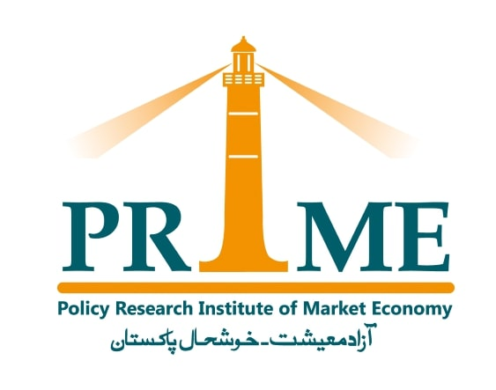
Striving for an open, free and prosperous Pakistan

