Slide 1
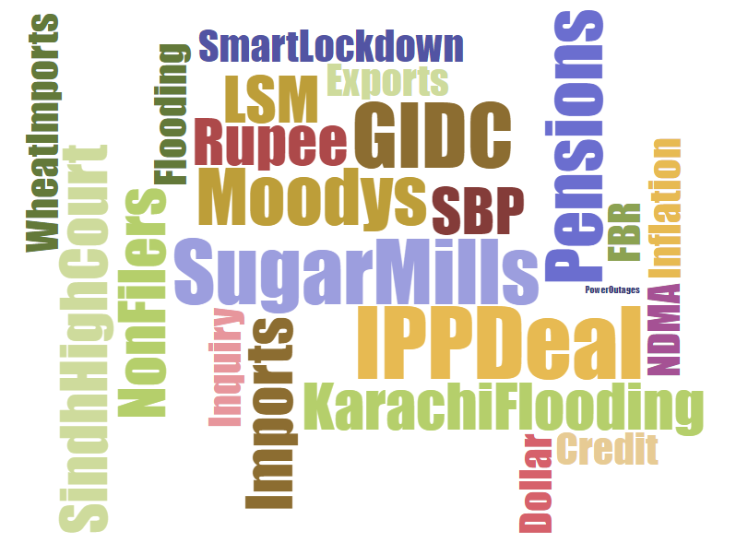
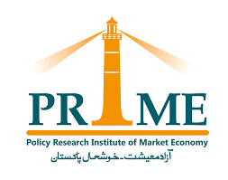
Pakistan prosperity index
November 2020

Slide 2
Policy Research Institute of Market Economy (PRIME) is a public policy think tank striving for an open, free and prosperous Pakistan by creating and expanding a constituency for protective function of the state and freedom of the market.
Pakistan Prosperity Index is a monthly review of Pakistan's macro-economy based on the analysis of four periodic data sets - industrial production, trade volume, price levels, and private sector lending. On a 12-month rolling basis, this issue of the report covers the period Sep 2019 to Aug 2020, with Jun 2019 as the base period.
Credits
The idea of Pakistan Prosperity Index was developed by Ali Salman. Special thanks to Ali Kemal for technical support in developing the indices and Sohaib Jamali for his valuable feedback. To view data and methodology, please click here.
Author
Shehryar Aziz
Email: shehryar@primeinstitute.org
Published by: Policy Research Institute of Market Economy (PRIME)
November 2020
© PRIME Institute
All publications by PRIME can be viewed online at primeinstitute.org

Slide 3
Pakistan prosperity index
Pakistan Prosperity Index inches lower to 103.7 in August - a decline of 3.8 percentage points as compared to July. Over a 12-month period, the trend faces a downward-sloping trajectory.

Slide 4
Purchasing power index (ppi)
Y-o-Y inflation for August recorded at 8.2%. As against base value of 100 in Jun 2019, PPI lower at 89.1 in Aug 2020

Slide 5
Large-scale manufacturing index (LSMI)
Output of large-scale manufacturing industry faced a sharp hit. As against the index value of 101.4 for July, LSMI stood significantly lower at 94.6 in August.

Slide 6
Trade volume index
As compared to July, total trade volume contracted by12.6% in August.

Slide 7
Private sector lending index (psli)
Fixed investment loans disbursed to the private sector grew by 6.8% in August 2020, to reach Rs. 246.4 billion. PSLI has improved to 156.8 in August as compared to 146.9 in July.

Slide 8
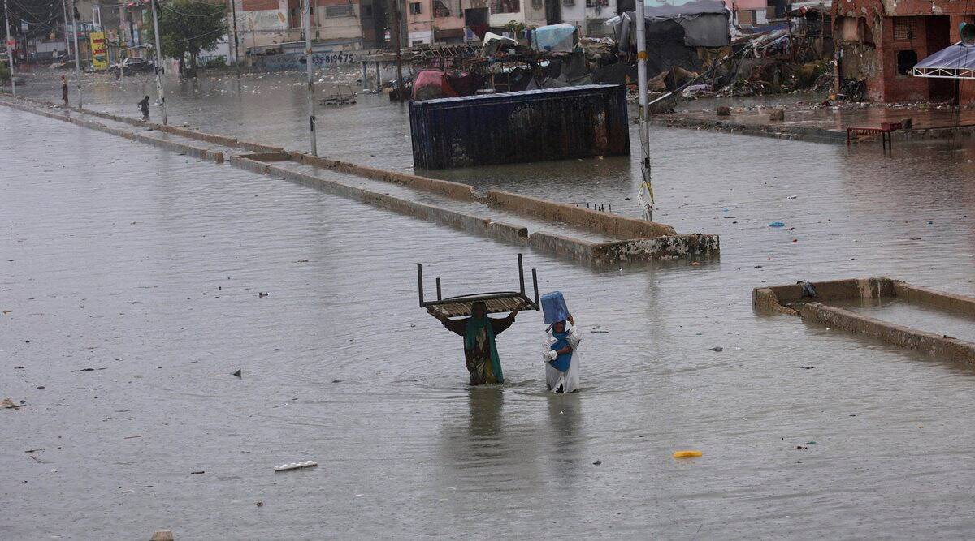
Wide-scale flooding across various parts of the country, in particular Karachi, had a serious toll on the economy in August. The port city received heaviest rainfall ever recorded in a single day, over a span of 53 years. Port operation saw suspension and several areas of the city underwent a forced power black-out to prevent damage due to electrocution.
Over a 12-month period, stagnancy in international trade and large-scale manufacturing position, together with near double digit inflation rate is resulting in downward-sloping economic prosperity.

