Slide 1
Economic and Fiscal Transformation:
Tax Administration Reform – Case of Georgia
Alex Aleksishvili
Islamabad, Pakistan
November 2024

Slide 2
Economic Profile Georgia (2023)
GDP: $ 30.54 billion
Nominal GDP Per Capita: $ 8.170
Real GDP growth: 7.5%;
Unemployment rate: 16.4%;
Inflation rate: 2.5%;
Exports $6 billion; Imports $15.4 billion
Main Export Partners: CIS (65.9%) | (Azerbaijan - 14.2%, Armenia – 12.9% , Kazakhstan – 11.5%, Kyrgyzstan – 11.4%, Russia – 10.8%), EU (11.6%), Türkiye(6.7%), China (5.1%)
Main Import Partners: EU (24.6%), CIS (21.3%) | (Russia - 11.3%, Azerbaijan – 4.2%, Armenia 2.2%), Türkiye(16.6%), USA (12.6%), China (8.6%)
The Central Bank of Georgia Interest Rate: 8% (October 2024)
Budget Deficit: 4.3% of GDP
The External Debt: 39.2% of GDP
Source: Geostat

Slide 3
Nominal GDP and Real GDP Growth (1988-2024*)
Main Reforms
Dissolution
of the USSR
Notes:
Real GDP growth: 7.5%; 5.6% on average (2019-2023)
Unemployment rate: 16.4%; 18.1% on average (2019-2023)
Inflation rate: 2.5%; 6.8% on average (2019-2023)

Slide 4
GDP Per Capita (1988-2024*)
Notes:
Real GDP growth: 7.5%; 5.6% on average (2019-2023)
Unemployment rate: 16.4%; 18.1% on average (2019-2023)
Inflation rate: 2.5%; 6.8% on average (2019-2023)

Slide 5
Georgia: FDI (1997-2023)
Source: World Bank

Slide 6
Georgia: Other Indexes
Georgia's HDI value for 2022 is 0.814— which put the country in the Very High human development category—positioning it at 60 out of 193 countries and territories. Between 2000 and 2022, Georgia's HDI value changed from 0.694 to 0.814, a change of 17.3 percent.
Georgia has a Gender Inequality Index (GII) value of 0.283, ranking it 69 out of 166 countries in 2022.
According to the Multidimensional Poverty Index, between 2012 and 2023, 15.6% of the population lived below the monetary poverty line, while 5.5% lived on less than PPP $2.15 a day.
Georgia’s economic freedom score is 68.4, making its economy the 32nd freest in the 2024 Index of Economic Freedom. Its rating has decreased by 0.3 point from last year, and Georgia is ranked 19th out of 44 countries in the Europe region. The country’s economic freedom score is higher than the world and regional averages. Georgia’s economy is considered “moderately free” according to the 2024 Index.
Georgia is 53rd in the overall Prosperity Index rankings. Since 2011, Georgia has moved up the rankings table by 9 places.

Slide 7
Pre-Reform Background: Collapse of Georgia’s Economy in the 1990s​
Collapse of supply chains following dissolution of USSR leading to drastic reduction in trade​
1992: Russian central bank stopped supplying Georgia with banknotes​; Soviet Ruble currency previously entirely controlled from Moscow
1993: Coupons introduced by Georgian Central Bank leading to coupons becoming the main currency​
1994: Introduction of IMFs Economic Recovery Program in Georgia
Cutting the Central Bank’s subsidization of the budget deficit​
Halting subsidization of products including bread, energy, gas, etc.​
1995: Introduction of Lari: 1 million coupons to 1 Lari​; 20 trillion coupons (48 million USD exchanged within 1 week​)
Introducing tax code
​
 | 1991 | 1992 | 1993 | 1994 | 1995 | 1996
Real GDP (% change) | -20.6 | -44.8 | -25 | -11 | 2.4 | 10.5
Inflation (% change) I/ | 173.1 | 1177 | 7488 | 6474 | 57.4 | 13.9
Tax to GDP Ratio (%) | 21 | 8 | 2 |  | 5 | 7
Fiscal Deficit (%) | 3 | 25 | 26 |  | 12 | 15
Real Minimum Wage Index I/2/ | 100 | 101.5 | 14.9 | 8.5 | 32.4 | 44
Energy Import Prices
Gas (US$/1,000m3) |  | 16.1 | 85 | 74 | 80
Refined Oils (US$/ton) |  | 3.6 | 81.4 | 146 | 206 | 183

Slide 8
Pre-Reform Background: Georgia’s Economic Challenges in 2003
Total corruption in all areas
Lack of government transparency and credibility
Absence of unified and coordinated development policy
High budget deficit
Governance & Rule of Law
Tax revenue - 13% of GDP
Budget arrears - 70% of the budget
External debt - 45% of GDP (But almost defaulted by the lack of fiscal discipline)

Slide 9
Georgia’s Economic Reform Overview
01
Reducing total burden of taxes
Improving collection and administration
Improving self-compliance
Tax Administration and Policy
02
Free Trade
An average weighted import duty of 1.5%​
No export duties.
FTAs with all major partners
03
New Instruments: MTFF, BDD
Fiscal Rules by constitutional law
All PFM in the Budget Law
Budget Policy
04
Licensing and Permits
“Zero Plus” Methodology
Eliminated 84% (756) licenses&permits
Decreasing beaurecracy
05
Privatization
Large-scale privatization in all economic fields
Limiting the size of public sector and demonopolization
Redirecting privatiozation income towards debt
06
Monetary Policy
Floating exchange rate
Inflation targeting
Strenghtening banking supervision

Slide 10
Concept of “Good Tax System”
Easy and simple tax legislation (one Tax Code)
Low tax rates - only six taxes at low rates
Universality (no exemptions)
Corruption free ​(no tolerance to corruption)
Internationally competitive tax environment
Trustworthy cooperation with businesses (2004 amnesty for audit and control, discussing amendments)

Slide 11
Factors for Successful Tax System
Political Framework: High Political Support, coordination with law-inforcement institutions, economic sector ministries
Policy Framework: Taxes, Rates, Priorities, etc.
Legal Framework: Clearity, legal structure, etc
Institutional Framework: Organizational structure, coordination, subordination, reporting, etc.
Human Resources: Training Facility, Researve, cooperation w Private Sector
Hard Infrastructure: Service Centers, Back offices.
Soft Infrastructure: ICT, E-solutions, Call Center.

Slide 12
Tax Policy and Administration Reforms in Georgia
Main goal: universal, easy to understand and simple to implement tax system with low rates
Improved Collection and Administration
Improved business registration, e-filing and payment systems
Dispute Resolution - Appeals Board (2 levels - under MoF and RS​)
Tax Ombudsman
Ensuring Self-Compliance
Reducing Number of Taxes to 6:
Personal Income Tax
Corporate Income Tax
Vat
Excise Tax
Customs Duty
Property Tax

Slide 13
Overview of the Tax Reform
TYPE OF TAX | <2005 | 2005/ 2006 | 2007 | 2008 | 2009 | 2010
Personal Income Tax | Diff. 0%, 12%, 17% and 20% | 12% | 12% | 25% | 20% | 20%
Social Tax, paid by employer | 31% | 20% | 20% | - | - | -
Social Tax, paid by employee | 2% | - | - | - | - | -
Corporate Income Tax | 20% | 20% | 20% | 15% | 15% | 15%
Dividends | 10% | 10% | 10% | 10% | 5% | 5%
Interests | 10% | 10% | 10% | 10% | 7.50% | 5%
VAT | 20% | 18% | 18% | 18% | 18% | 18%
Export | 0% | 0% | 0% | 0% | 0% | 0%
Excise | Differentiated
Property Tax for Enterprises, other that land | 1% | 1% | 1% | 1% | 1% | 1%
Customs Duties | Differentiated 0-30%, Average weighted 7.6 |  | Differentiated, 0%, 5% & 12%, Average weighted 1.5

Slide 14
Overview of the Tax Reform
TYPE OF TAX | <2005 | 2005/ | 2007 | 2008 | 2009 | 2010 | 2011 | 2012 | 2013
 |  | 2006
Natural Resources Usage Tax | Diff. |  | Transferred into fee
Gambling Tax | Diff. |  | Transferred into fee
Vehicles Tax | Diff. | Abolished
Tax on Vehicles Ownership Rights Transfer | Diff. | Abolished
Tax on Property Ownership Rights Transfer | Diff. | Abolished
Environment Hazard Tax | Diff. | Abolished
Tax on Vehicles Overweighting | Diff. | Abolished
Fixed Tax | Diff. | Abolished
Tax on Small Size Business | 5% | Abolished
Resorts Tax | Diff. | Abolished
Hotels Tax | Diff. | Abolished
Advertising Tax | Diff. | Abolished
Symbolic Usage Tax | Diff. | Abolished
Land Tax | Diff. | Abolished
Tax on Gifts and Heritage | Diff. | Abolished

Slide 15
Economic and Finance Crime Investigation
Collection/
Administration
Dispute Resolution
Services
Audit
Registration – Business Registration in one place (+property registry).
Service unit is separate from all other units only helping taxpayers
Fiscalization
Focus on phases of VAT
Focus on corpodate level of PIT and CIT
Collection department focus on collection of declared liabilities using various tools: tax guarantees, leans, etc.
All fiscal/ tax inspection under the RS
The problematic in terms of skils and HRM.
It is important because:
courts do not have enough experience in taxes
Both sides (business and Tax Authority) need to make fast decision
Our purpose is to track the tax environment and know what is the problem
2 level tax dispute resolution system: RS and MOF.
Semi autonomus unit within the Min of Finance
Double subordination: a. Min of Finance and b. Prosecutor General

Slide 16
Tax to GDP and Size of Government
Tax to GDP ratio has improved drastically since 2004
Georgia Tax revenue: % of GDP was reported at 25 % in 2023
Government total expenditures are standing at 30% to GDP, abnormal case were in 2008-9, and 2020-21
Capital Expenditures drastically increased from 2% to GDP to 10%

Slide 17
Georgia’s Tax Structure 2023
Source: Geostat

Slide 18
Georgia Government Revenue (2023)
Total Revenues (22,124,2 Mln. GEL)
Taxes (89.2%)
Social Contributions (-)
Grants (0.9%)
Other Revenues (9.1%)
Income Tax (30.8%))
VAT (42.5%)
Profiit Tax (10.2%)
Excise (11.5%)
Property (3.3%)
Custom Tax (0.8%)
Source: Ministry of Finance of Georgia

Slide 19
Overview of Personal Income Tax
2005: Progressive income tax rate changed by flat rate
2008: Social Tax was abolished, and income tax rate became from 12% to 25%
2009: Policy change – income tax rate further decreased to 20%, but also effected by War and GFC
Since 2010: Increase share in total tax revenue, and acceding 25% of total tax revenue

Slide 20
Overview of Corporate Income Tax
Due to significant improvements in tax and customs administration, CIT drastically increased from 1.5% (2004) of GDP to 3% (2008)
2005: the rule for 100% depreciation for assets is in power
2007 vs. 2008 – policy change; in 2008 tax rate decreased from 20% to 15%
In 2017 Estonian Model of CIT was introduced : Only distributed income is taxable

Slide 21
Overview of Value Added Tax
Equal VAT on imported and local goods
High increase in revenues from VAT since 2004
20% before 2005 – 18% since 2005
VAT exemption – the most sensitive – in 2005 dramatically eliminated the number of tax exemptions
VAT refund within 1 and 3 months

Slide 22
Overview of Excise Tax
Equal excise tax on imported and local goods
Excise is paid on following type of products: Vehicle, Alcohol, Tobacco, Oil and Oil Products, Natural Gas and its Condensates
High increase in excise revenue from 2002 to 2018 (from 1% to 3%) mainly due to improved administration
In 2012 policy changes in taxing tobacco and oil products

Slide 23
Overview of Property Tax
Property tax also includes land tax
Less then 1% of GDP
Less volatile tax basis
Source of revenue for local budgets

Slide 24
International Trade and Customs Duties​
Import tariffs reduced for 85% of goods. Import duties on agricultural goods and construction materials
An average weighted import duty of 1.5%
Freeing export and re-export from Georgia: no export and re-export duties​
Equalized VAT and excise duty on local and imported goods​
Signed major FTAs including with the EU, Turkey, and China​

Slide 25
Complicated Fiscal Instituional Structure
Fiscal:
Ministry of Finance
Tax Department
Customs Department
Ministry of Internal Affairs for financial crime
Fiinancial Police
Social Assurance Agency
State Fund
Boarder Control:
Ministry of Finance
Customs department
Ministry of internal affairs
Road and transport department
Fiinancial Police
Statistics Department
Business Registration and inspections:
District court
Tax Department
Statistics Department
Local Authority
Licensing agency (relevant for sector)
All kind of inspections (in each sector)

Slide 26
Tax Administration: Quick Facts
Quick and comprehensive reorganization (I phase) 2004-2005 number of employees in state tax department decreased from 2500 to 1800 and in customs department from 2000 to 1400
Excise Tax Inspection – created in 2003 and abolished in 2008
United Tax and Customs Department- State Revenue Service-SRS (II phase)
Large Tax-Payers – Created in 2000 and abolished in 2010
Audit Department – created in 2009

Slide 27
Structural Changes Over Time
Before 2004
2004-2007
2007-Current
2010-Current
Ministry of Finance
Central Apparatus
Treasury Service
Budget Unit
International Unit
Policy Unit
Treasury
Central Apparatus
Ministry of Finance
Tax
Customs
Financial Police
Treasury
Central Apparatus
Ministry of Finance
State Revenue Service
Service
Audit/ Inspection
Administration/ Collections
Investigation
Treasury
Central Apparatus
Ministry of Finance
Financial Investigation
Revenue Service LEPL
Ministry of Tax Revenue
Tax Department
Customs Department
Financial Legion

Slide 28
Functional Structure of the Tax system in Georgia
Previous system
Functionally Decentralized Structure
Revenue Service
Local Offices
Service
Administration
Audit
Revenue Service
Service
Administration
Audit
Service units in Local Offices
Administration units in Local Offices
Current system
Functionally Centralized structure

Slide 29
Reforms in Registration, Licenses & Permits
Business registration is conducted only in tax authority, taking only 1 business day
Eliminating licenses and permits: “Zero Plus” Methodology was implemented
Total number of licenses and permits reduced by 84% (756 licenses and permits)
Streamlining procedures
On average 30 days required for licenses and 20 for permits
Licensing and permits required only for:
Health and Safety Protection
Security of living conditions and cultural environment
Protection of state and public interests
"Silence is consent" - a permit or license is automatically granted if no government action is taken within statutory time limits.
Reforms in Public Registry and Civil Registry. Improve civil services.

Slide 30
Public Service Hall
Structures Under Public Service Hall
The old system of public services were characterized to have heavy procedures, requiring too much time and be highly corrupted
In 2005, started the implementation of “the principle of one window“ - receiving service of one agency in a single place, simplifying procedures, enhancing information management and control.
At a later stage, the decision was to unite all the institutions working according to the principle of "one window" in one building, in one space
Challenge: unification of large number of services could cause to lose the speed and efficiency in service deliver – could cause the emergence of new bureaucracy
National Bureau Enforcement
National Archive of Georgia
National Agency of Public Registry
Civil Registry Agency
Notary Chamber of Georgia

Slide 31
Provided Public Services
Property Registration:
Registration of the right to ownership of the state on immovable thing
Right to ownership of condominium of the immovable thing
Registration on mortgage on the right to build
Registration of rental on immovable property
And etc…
Enforcement Services:
Removal of the property from illegal use
Unsecure Claim
State Excise
Enforcement to Secure the Suit
And etc…
Archive Services:
Certificate of Work Experience
Certificate Confirming the Property Right
Certificate of Birth, Death, Marriage and Divorce
And etc…
Individual:
Passport
Residence Card
Citizenship
Visa
Birth Registration
Apostil/Legalization
And etc…
Business Registration:
Individual Entrepreneur
Enterprise Re-domicile
Registration of Annulment
And etc…

Slide 32
International Institutions’ Activity in Georgia
IMF – Economic Assistance:
Financial Support
Policy Advice and technical assistance
Surveillance, Assessment and Evaluation
Engagement on Reforms
The World Bank – Development Projects:
Infrastructure Development and Environmental Sustainability
Public Sector Reform
Social Policy Initiative, Poverty Reduction and Social Inclusion
Private Sector Development
Regional Development
The USAID – Democracy Promotion:
Democracy and Governance
Economic Development
Health, Education, and Social Services
Energy and Environment
The European Commission – Integration Assistance:
Support for reforms
Financial Aid and Investment
Human Rights and Social Issues
Culture Exchange and Education

Slide 33
Georgia’s Doing Business Overview (2006-2020)
 | Ease of Doing Business | Starting a Business | Dealing with Construction Permits | Registrating Property | Paying Taxes | Trading Across Borders
2006 | 100
2007 | 37 | 36 | 42 | 16 | 104 | 95
2008 | 18 | 10 | 11 | 11 | 102 | 64
2009 | 15 | 4 | 10 | 2 | 110 | 81
2010 | 11 | 5 | 7 | 2 | 64 | 30
2011 | 12 | 8 | 7 | 2 | 61 | 35
2012 | 16 | 7 | 4 | 1 | 42 | 54
2013 | 9 | 7 | 3 | 1 | 33 | 38
2014 | 8 | 8 | 2 | 1 | 29 | 43
2015 | 15 | 5 | 3 | 1 | 38 | 33
2016 | 24 | 6 | 11 | 3 | 40 | 78
2017 | 16 | 8 | 8 | 3 | 22 | 54
2018 | 9 | 4 | 29 | 4 | 22 | 62
2019 | 6 | 2 | 27 | 4 | 16 | 43
2020 | 7 | 2 | 21 | 5 | 14 | 45
Source: World Bank

Slide 34
Georgia’s Doing Business Overview (2006-2020)
Georgia’s Ease of Doing Business ranking saw drastic improvement, moving from 100th in 2006 to 37th in 2007. Since then, Georgia’s rank has continued to improve, reaching its highest position of 7th in 2020.
In terms of starting a business, Georgia demonstrated remarkable progress, decreasing its rank from 36th in 2006 to an impressive 2nd place in 2018. This change reflects substantial improvements in regulatory processes and business facilitation.
Georgia also made significant strides in dealing with construction permits, improving its ranking from 42nd in 2007 to 11th in 2008. From 2008 to 2017, Georgia maintained high rankings, achieving its best position of 2nd in 2014. However, from 2018 to 2020, there has been a noticeable decline in this area.
In property registration, Georgia held the number 1 rank for four consecutive years (2012-2016), showcasing its effectiveness in this aspect.
The consistent improvement in paying taxes is noteworthy, with a substantial drop from 110th in 2008 to 14th in 2020. This reflects a steady reduction in the tax burden and enhanced efficiency in the tax system, benefiting businesses operating in the country.
From 2007 onwards, Georgia improved its trading across borders ranking, reaching a peak of 30th in 2010. However, since then, there has been a series of fluctuations, with the rank dropping to 78th, the lowest since 2007.

Slide 35
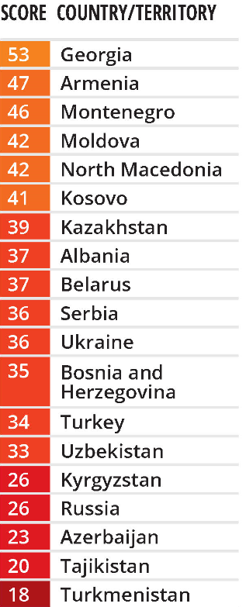
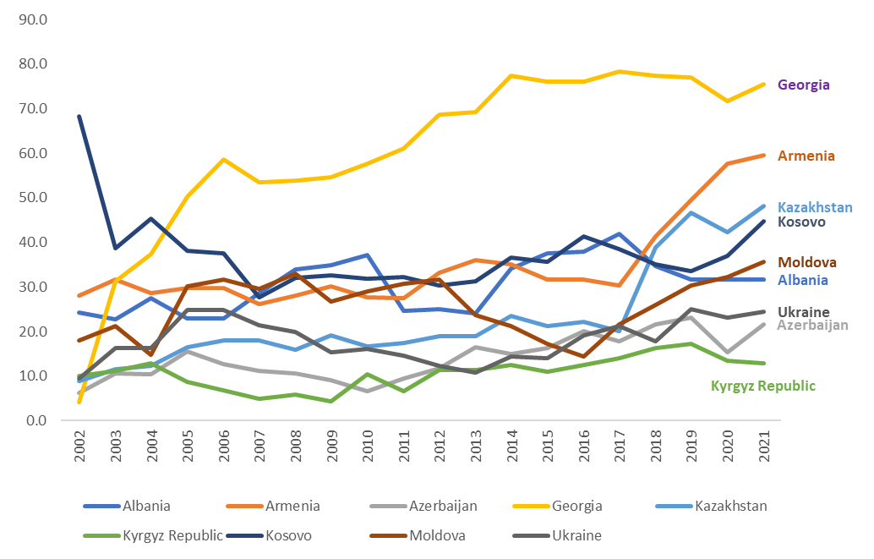
Corruption: Georgia and the Region
Georgia has a score of 53 out of 100 on the Corruption Perceptions Index (CPI), ranking 49th among 180 countries
Source: World Bank and Transparency Agency

Slide 36
Obstacles During the Reforms:
Bureaucracy and Institutional Capacity
Political Instability
Mistrust from the public and potential partners
Regional Conflicts
External Pressure

Slide 37
Lessons Learned and Steps Ahead
Accomplishments and Improvements:​
Taxes paid - dominant source of revenue
Competitive tax environment internationally
Reducing corruption on all levels​
Promoting a sustainable business climate by supporting fair and equitable entrepreneurship​
Remaining Challenges​:
Judiciary system and the rule of law​
Structural unemployment and gaps in human capital​
Economic diversification ​
Reforming SOEs

Slide 38
Thank you
USA:
1725 I Street, N.W. Suite 300 Washington, DC 20006
Phone: + 1 (202) 640 5441
GEORGIA:
61 Aghmashenebeli Avenue, 4th floor Tbilisi 0102
Phone: + (995) 577 170660
UKRAINE:
1/4 Lesi Ukrainky blvd, office 18-b, Kyiv, 01133
Phone: +38 (097) 0998337
office@pmcginternational.com
www.pmcg-i.com
Visit Our Website
Annual Reports: https://pmcg-i.com/annual-reports/
Products: https://pmcg-i.com/products/
Publications: https://pmcg-i.com/publication
Listen to Our Podcast
Podcasts: https://pmcg-i.com/category/podcasts/
Follow Us on Social Media:
LinkedIn: https://www.linkedin.com/company/policy-and-management-consulting-group-llc
Facebook: https://www.facebook.com/pmcginternational

